Slide 1
Big Data Analysis and Predictive Model for NFL Running Backs: Draft Likelihood and NFL Success
Ben Fitzgerald

Slide 2
Introduction
NFL Draft Process
Annual event where NFL teams select college players to join their rosters
Consists of multiple rounds, with the poorest performing teams picking first
The right draft selections are crucial for teams to be competitive in the NFL
Each team has a limited number of picks, emphasising the importance of picking the correct player

Slide 3
Introduction
Player Evaluation
Involves assessing players’ skills, athleticism, and potential for success.
Considers performance metrics from the NFL Combine, College and various other metrics
Utilises subjective evaluations by scouts and coaches
Effective player evaluation enhances teams’ ability to make informed draft selections and build competitive rosters

Slide 4
Challenges in NFL Player Evaluation
NFL Teams face significant challenges in accurately evaluating college football players during the NFL Draft
Traditional scouting methods rely on subjective evaluations and limited statistics, leading to uncertainties and missed opportunities
Drafting the wrong player can result in substantial financial losses and hinder team competitiveness in the league
This project aims to address these challenges by leveraging big data analytics and machine learning to provide predictive models for player assessment

Slide 5
PROBLEM VS. SOLUTION
PROBLEM
SOLUTION
Teams face challenges in accurately evaluating collegiate players’ potential for success in the NFL
Develop predictive models tailored to running backs leveraging data analysis techniques such as statistical modelling and machine learning algorithms to enhance player evaluation and draft selections.

Slide 6
Requirements for the Application
Data Acquisition
Data Cleaning
Model Development
Model Evaluation
Model Deployment
Scalability and Future
Scrape NFL data, extract player URLs for stats
Address missing values, ensure data integrity
Develop ML models for draft likelihood & NFL success
Assess model performance and validate with recent data
Deploy for upcoming NFL Draft
Design scalable architecture and plan for future features

Slide 7
Overview of Datasets Used
NFL Combine Data
NFL Draft Data
College Football Statistics
Pro Day Metrics
Comprehensive metrics from NFL Combine events spanning 2000-2023, scraped from Pro Football Reference
Detailed records of NFL Draft selections covering the same timeframe, scraped from Pro Football Reference
Extensive player performance data encompassing 2000-2023 seasons, scraped from Sports Reference.
Additional performance metrics from college pro day events, providing supplemental insights into player capabilities.

Slide 8
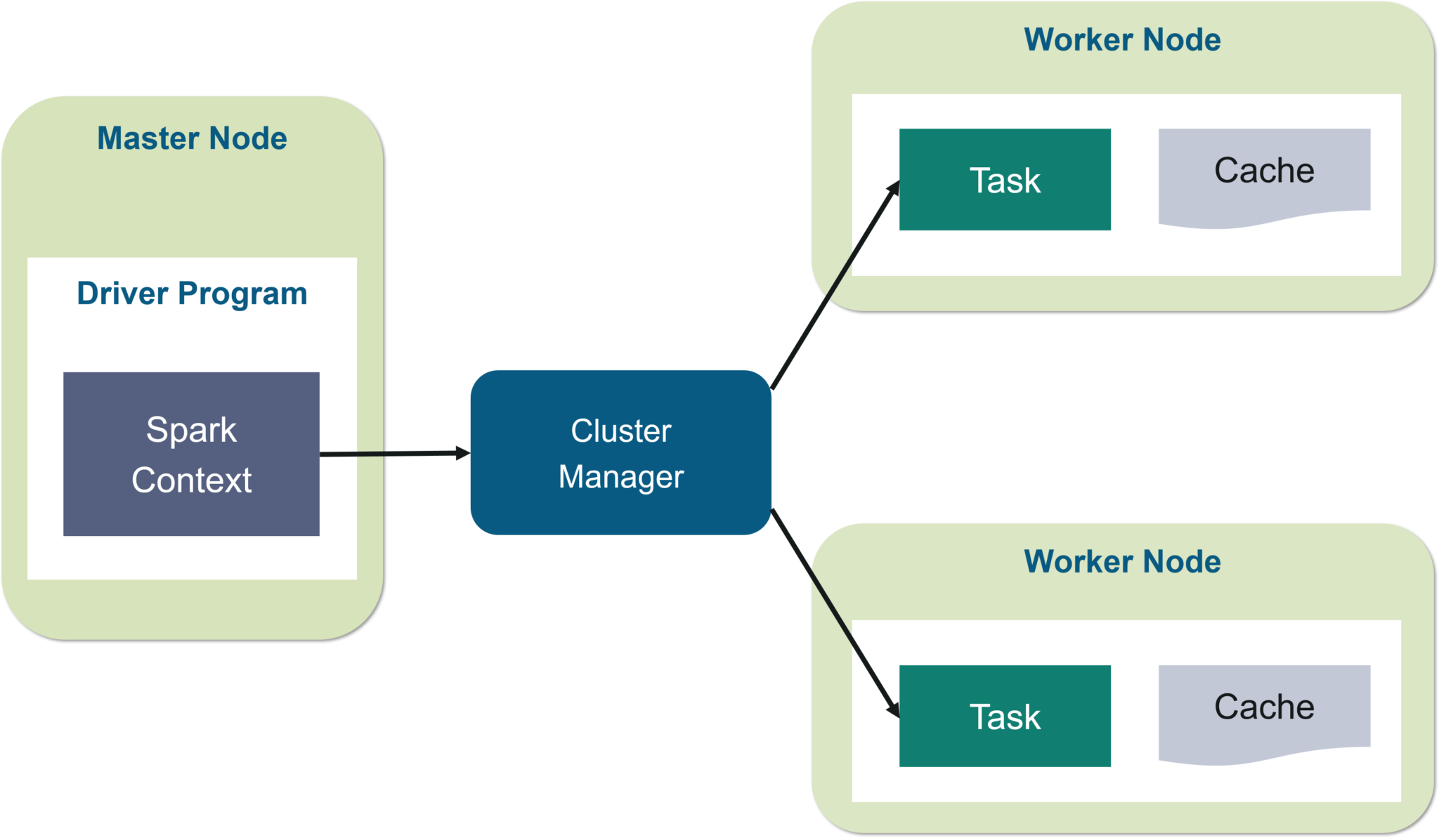
Apache Spark
Scalability
Fault Tolerance
Resiliency
Apache Spark scales horizontally, accommodating growing NFL datasets effectively
Spark's fault tolerance ensures continuous data processing despite system failures
Spark's distributed architecture minimizes the impact of node failures

Slide 9
Data Acquistion
Leveraged web scraping techniques using Python libraries like BeautifulSoup and Pandas to scrape NFL Combine and NFL Draft data from Pro Football Reference, using URL Extraction and HTML Table parsing for comprehensive data gathering
Implemented caching to minimize redundant web requests during scraping, ensuring efficient data retrieval and reducing processing time for large-scale data acquisition.
Narrowed the focus to running backs to streamline extraction, balancing data comprehensiveness with practicality, laying the foundation for detailed analysis and modeling specific to the project objectives

Slide 10
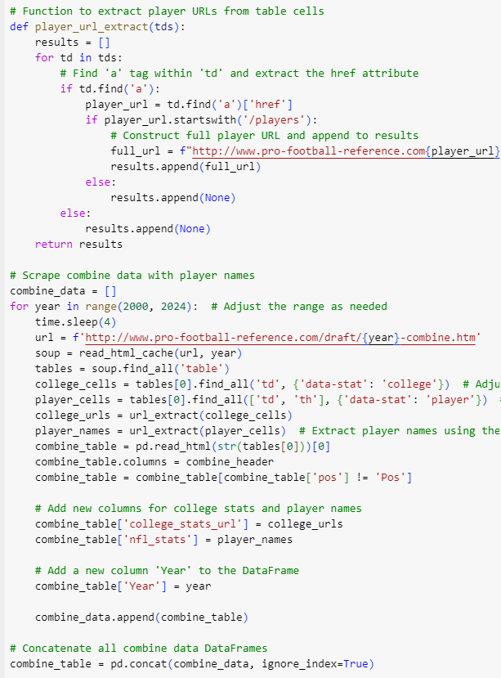
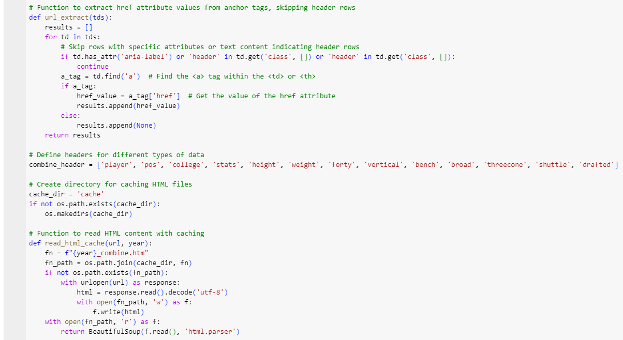
Data Acquisition
Functions used to scrape NFL Combine data, extract URLs and parse HTML tables, a similar process was done to gather NFL Draft and College Statistics data

Slide 11
Data Cleaning
Employed techniques such as data imputation and removal of incomplete records to ensure dataset integrity, addressing missing values, inconsistencies, and outliers for reliable analysis and modeling.
Utilised ‘coalesce’ to merge player attributes from Combine and Draft datasets, ensuring all players had essential attributes regardless if they were drafted or not
Split 'height' into 'feet' and 'inches', converting to total inches for uniformity in height representation across players.
Converted columns to appropriate data types (floats or integers), ensuring consistency and compatibility for analysis and modeling.

Slide 12
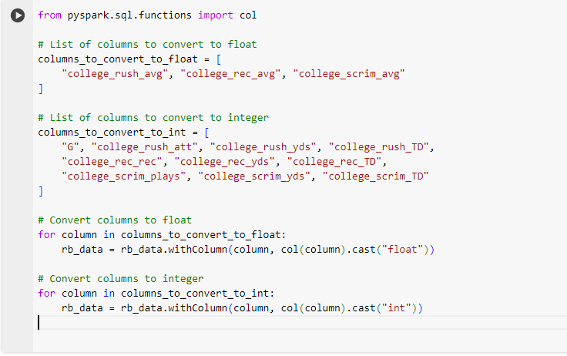
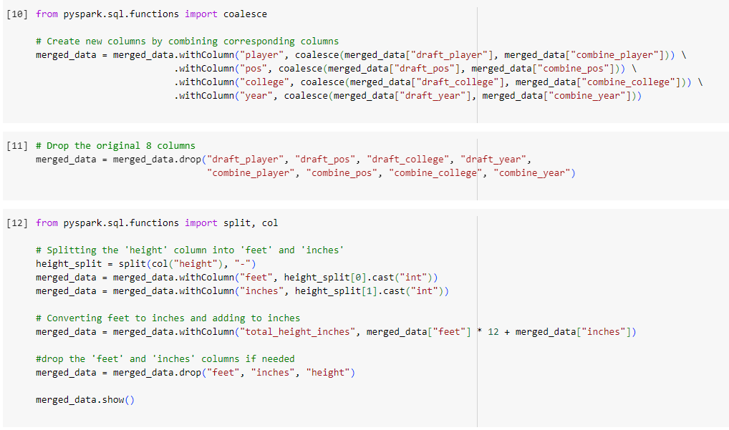
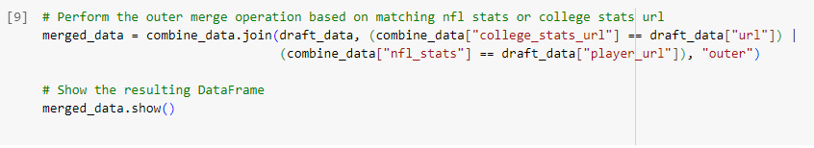
Data Cleaning

Slide 13
Model Development
Feature Selection
Algorithm Selection
Data Preprocessing
Model Training & Validation
Identify combine and college stats (e.g., 40-yard dash, vertical jump) most predictive of draft position.
Choose ML algorithms:
Draft Likelihood – Logistic Regression
NFL Success – Linear Regression
Handle missing values in players stats, normalize features for model training
Split dataset into training and testing sets, fine-tune hyperparameters for optimal performance

Slide 14
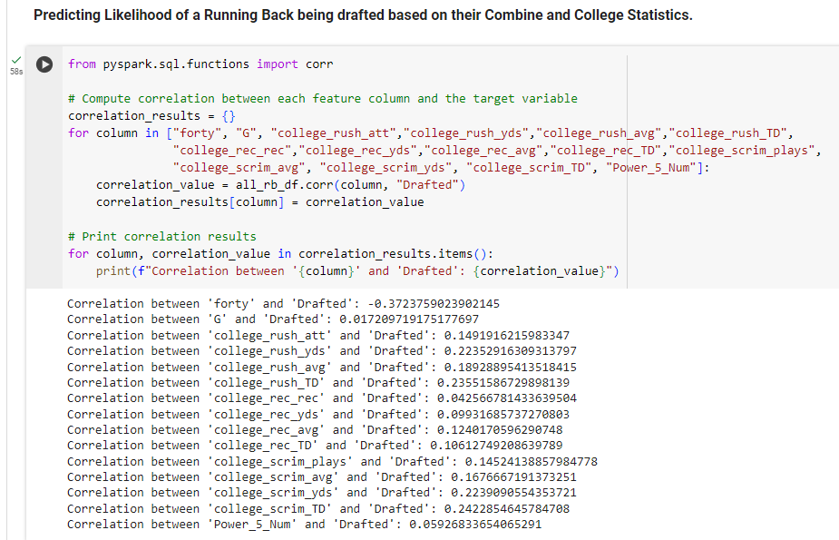
Model Development
Correlation Analysis between Combine and College stats and being drafted

Slide 15
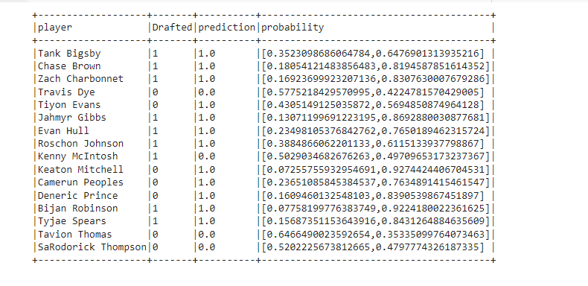
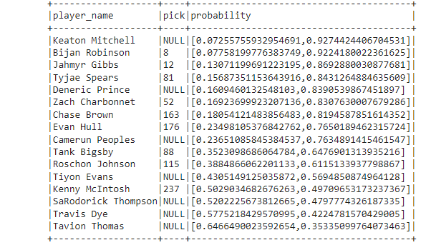
Model Evaluation – Draft Likelihood (2023 Draft)
The Draft Likelihood model predicted 11 out of 16 running backs draft status accurately
The model mistakenly thought Keaton Mitchell was going to be drafted (92% chance) but it did a good job with the top draft picks

Slide 16
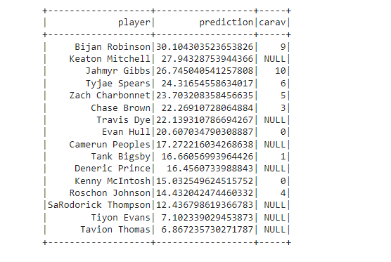
Model Evaluation – NFL Career Success (2023 Draft)
Unfortunately, there is no CarAV (Career Approximate Value) data for undrafted players but for those players that were drafted, it recognised Robinson and Gibbs as high potential players who have already accumulated 9 and 10 CarAV in their first season

Slide 17
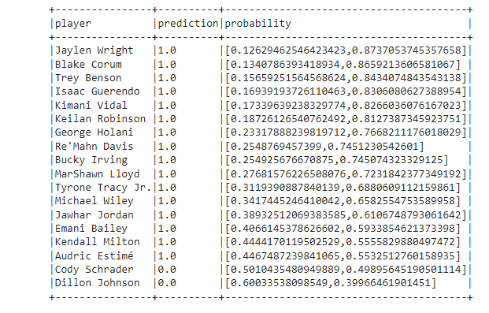
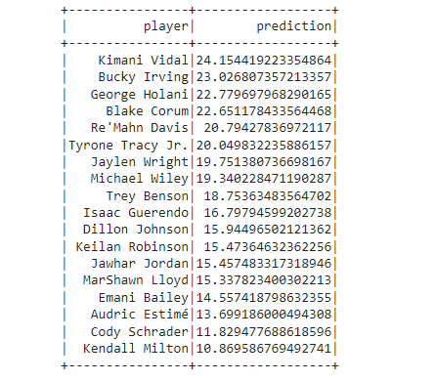
Model Deployment (2024 Running Back class)
The Draft Likelihood model predicts Wright, Corum, and Benson to be the most likely running backs drafted but the NFL Success model predicts Vidal, Irving, and Holani to accumulate the most CarAV in their NFL career

Slide 18
Future Work & Scalability
Expanded Position Coverage
Integration of Pro Data
Model Refinement
Scalability
Incorporate pro day statistics alongside NFL Combine data to enhance predictive models, capturing a wider range of player performance indicators.
Extend analysis beyond running backs to include quarterbacks, wide receivers, and defensive players, enriching draft insights across positions.
Experiment with diverse ML algorithms, parameter tuning, and ensemble techniques to boost prediction accuracy and adaptability across different player datasets.
Implement cloud-based solutions and robust data pipelines to handle increasing data volumes from NFL events, ensuring efficient processing and real-time insights for NFL teams

Slide 19
Addressing the Goals of Distributed Systems
Scalability
Concurrency
Availability
Fault Tolerance
Apache Spark enables high concurrency, processing extensive NFL player data in parallel
Leveraging Apache Spark ensures good scalability, handling large NFL player datasets efficiently
Distributed tasks ensure high availability, crucial for uninterrupted processing of NFL player data
Apache Spark’s fault-tolerant features ensure data integrity and reliability throughout NFL player data processing and modelling

Slide 20
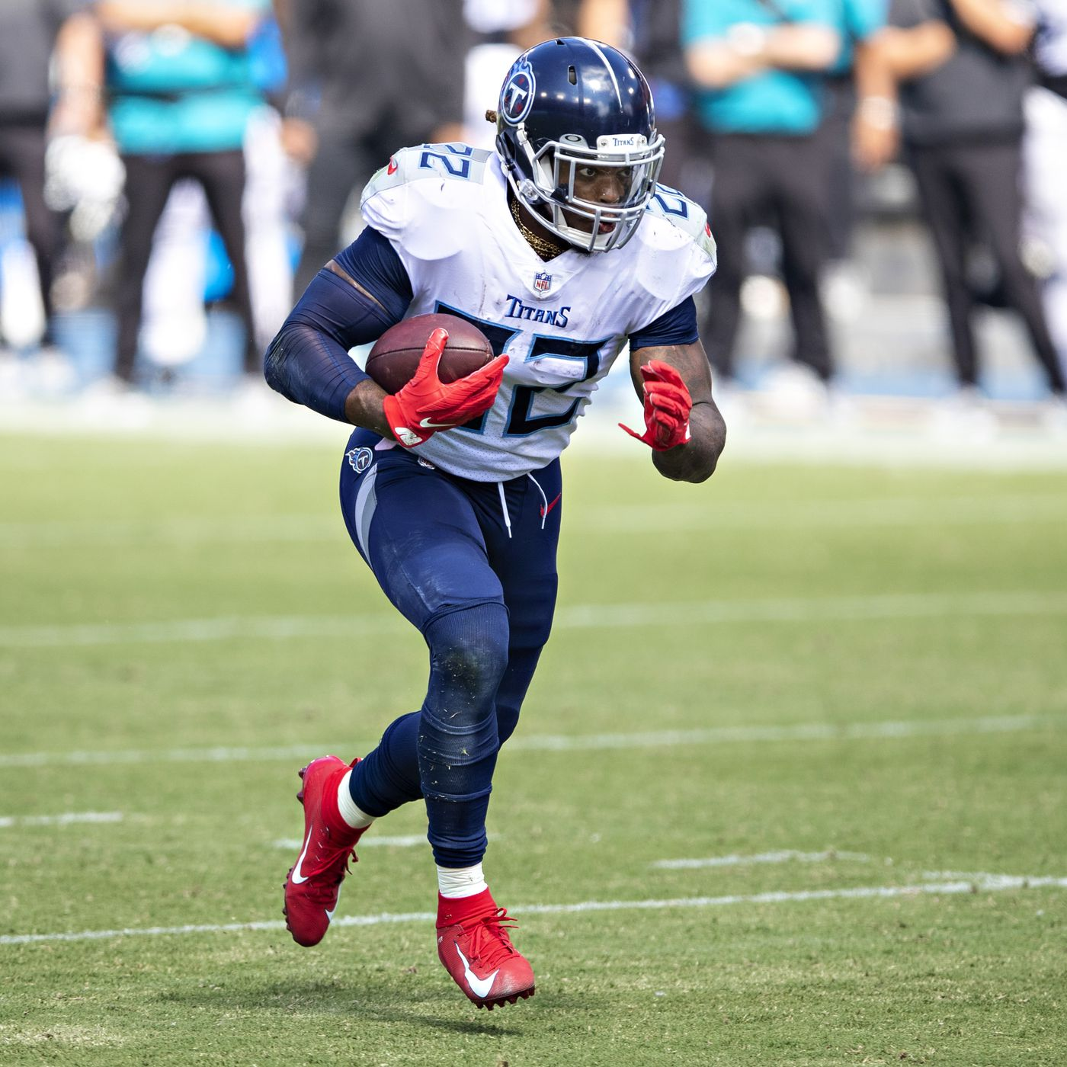
Thank You!
Are there any questions?

